Slide 1
Customer Segmentation (BigQuery)
Step
Query data from supermarket data
Create customer single view for those with CUST_CODE
5 features
Average day between purchase, Day since last purchase, Number of product per visit, Number of visit per week, Spend per visit
Create K-Mean using BigQuery ML
Try different value of K (Number of clusters)
Choose K that minimize Davies–Bouldin index (WSS/BSS) in order to maximize between sum of square and minimize within sum of square distance
See result of centroid value for each features
Interpretation and possible action for each cluster

Slide 2
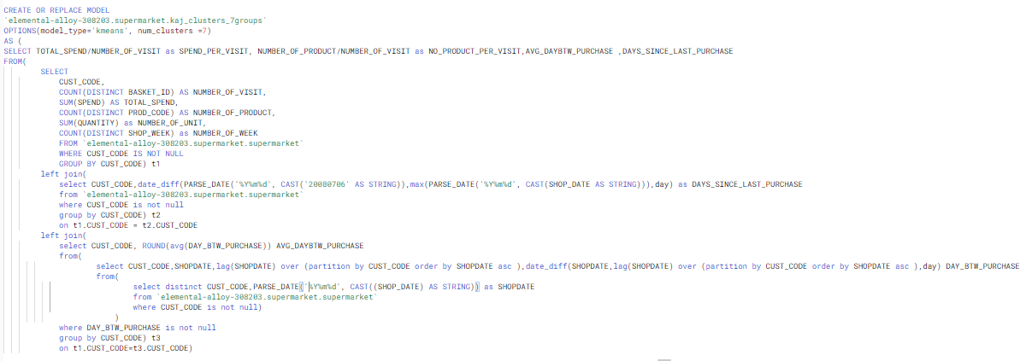
Query

Slide 3
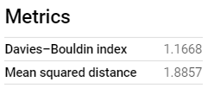
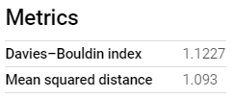
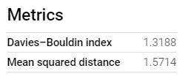

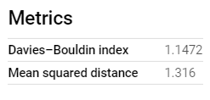
Try different value of K
K=3
K=6
K=4
K=7
Choose smallest Davies–Bouldin index
(Minimize WSS and Maximize BSS) but since
7 might be hard to interpret I will choose 6
K=5

Slide 4
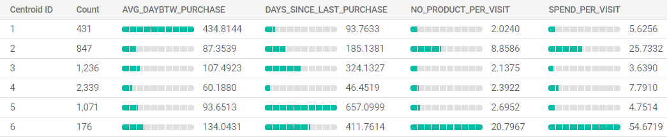
Interpretation of each cluster
6100 customers
Group1 – Purchase once a year, low spending
Group2 – High ticket size with several product per visit
Group3 – Low ticket size, purchase 3 times a year and have not purchased for almost a year
Group4 – Frequent purchaser with low ticket size and just purchased no more than 2 months
Group5 – Idle for almost 2 year but also have very low ticket size
Group6 – High ticket size, purchase many product but haven’t purchased for a year

Slide 5




Action: Focus on Group2&6
good
bad
neutral
Ticket size
Recency
Time to purchase
Variety
ACTION
Get them to purchase more frequent
Since time to purchase is almost a year
Group1
Get them to purchase again and try
To upsell to increase ticket size since
This group has 2nd highest ticket size
Group2
Try to get them to purchase again since
Their last purchase has been a year
Group3
Ignore since very low ticket size and they
Purchase regularly
Group4
Try to get them to purchase again since
Their last purchase has been 2 year
Group5
Give very special promotion especially
Get them to purchase again
since this group has highest ticket size
but Idle for year
Group6

